Slide 1

Status quo gear deburring
Groep 5:
Cedric Arentz (532214)
Gijs Winkelhorst (554028)
Sven Kerkhof (549116)
3-10-2025

Slide 2
Ter informatie
Deze slide mag weg, is puur voor tijdens het maken
De presentatie moet in het engels, we presenteren hem voor de hele klas
De presentatie moet ong 10 min duren
We gaan gewoon met zn 3en presenteren, en inspringen waar je verstand van hebt.
Workshops idef0 moeten er nog in

Slide 3
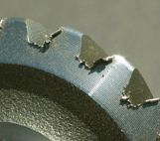
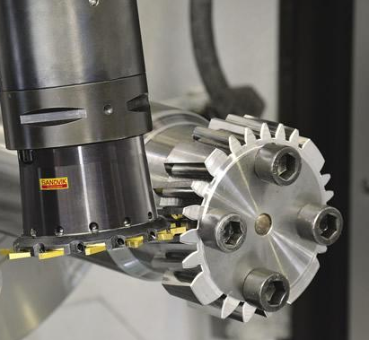
Introduction to project
Mr. Spikker
Huima BV
Deburring of gears
Proof of concept

Slide 4
Week 1
Choosing of project
Research about project
First market research

Slide 5

Week 2
Meeting with client
  weekly
Company visit
  Current solution: sandpaper wheel + plastic/steel brush
  Manual labor
Research
  Market
  project

Slide 6
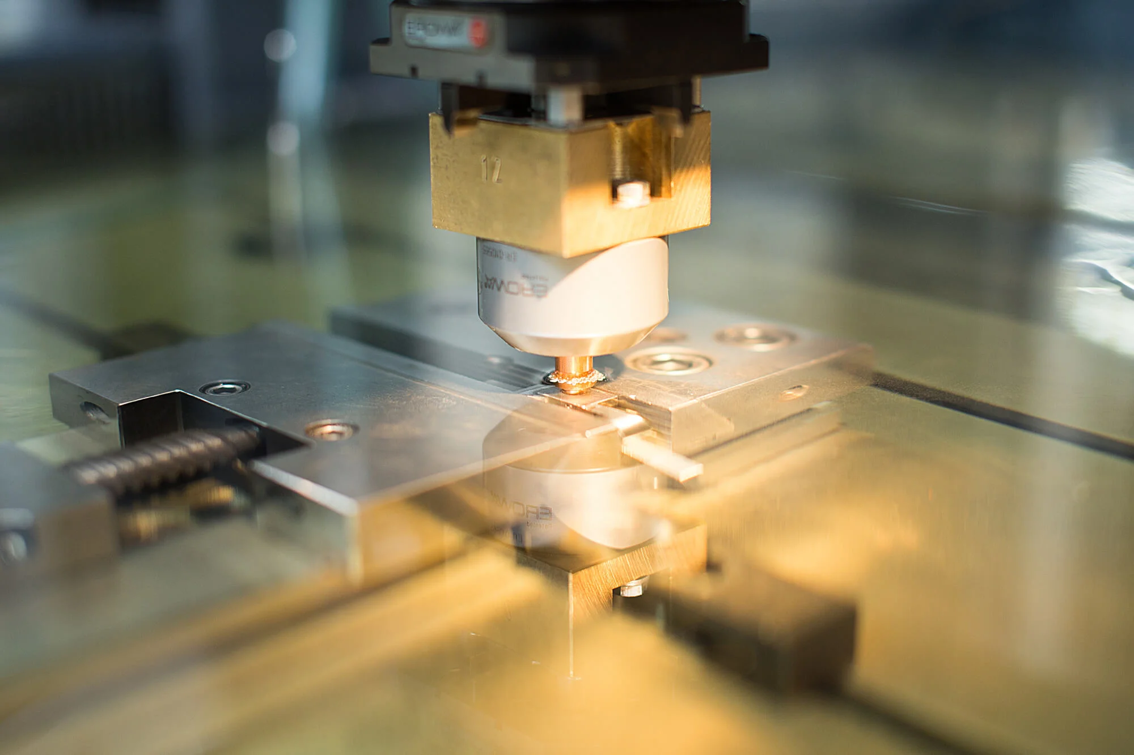
Week 3
Function scheme
Morfologic scheme
  EDM
  brush
first draft requirements document
  Table version
  Text version

Slide 7
Week 4
Combined requirements document
Schedule
Testing of concepts
  EDM would be possible
  brush is already proven
Start of idef0 diagram

Slide 8
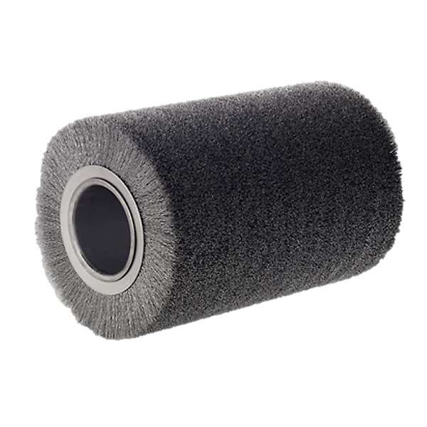
Week 5
EDM not an option -> brush
  Bed
  Gear tolerances
  cost
IDEF0 diagram
Actual concept drawings
  2 or 3 axis version?

Slide 9
Present (week 6)
'final' decision on concept to prove
  Presented to company and client
This presentation
Calculations
  Special parts to look into

Slide 10
future
Purchase part list
Solidworks drawings
Refinement Schedule for next quartile
  Deadlines for different assemblies
Building, testing, refinement (next quartile)

Slide 11
Questions?
Feel free to ask

